Slide 1

Databases
Denis McCarthy
Denis.mccarthy@tus.ie
RoomU302

Slide 2
Chapter 3
Data Model

Slide 3
The Importance of Data Models
Data model
Relatively simple representation, usually graphical, of complex real-world data structures
Communications tool to facilitate interaction among the designer, the applications programmer, and the end user
Good database design uses an appropriate data model as its foundation
End-users have different views and needs for data
Data model organizes data for various users

Slide 4
Data Model Basic Building Blocks
Entity is anything about which data is to be collected and stored
Attribute is a characteristic of an entity
Relationship describes an association among (two or more) entities
One-to-many (1:M) relationship
Many-to-many (M:N or M:M) relationship
One-to-one (1:1) relationship

Slide 5
The Evolution of Data Models
Hierarchical
Network
Relational *
Entity relationship *
Object oriented
* We will study these models in detail

Slide 6
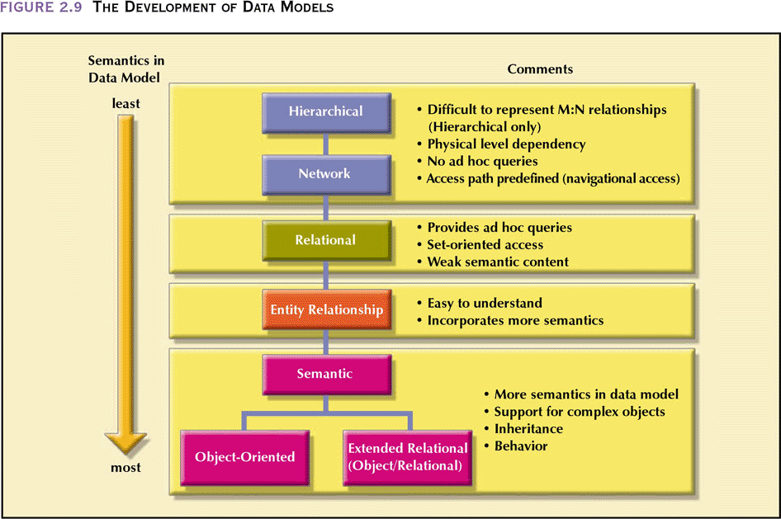
The Development of Data Models
Fig 3.1 The Development of Data Models

Slide 7
Hierarchical Model
Connect records in a tree like structure.
(D)Department
Name Totalenrol NoofPhd
(F)Faculty
Name Jobtitle
Name Rank Degree
(A)AdminStaff
Name Year Major
Cno Descr
(S)Student
(C)Course

Slide 8
Hierarchical Model
Can be useful for some applications which can be represented as parent-child relationships.
Handles one to many or one to one type relationships. Many traditional DP applications lend themselves to this approach.
Can’t handle many-to-many relationships or children unattached to any parent.
IMS (IBM 1987) has a DML which includes a Data Sub_language built into programming languages - Assembler, PL/1 and COBOL in IBM Computer Systems.

Slide 9
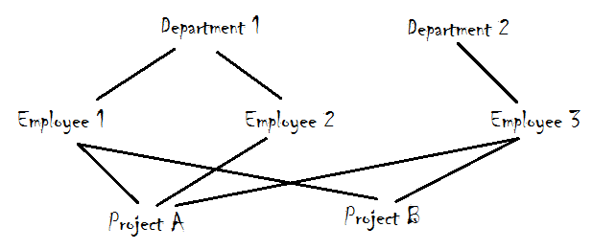
Network Model
A Network is represented as a graph.
The nodes in the graph are record types and the arcs between the nodes indicate relationships.

Slide 10
Network Model
Normally 1 to many relationships for ease of implementation but can also support many to many relationships.
Easy to store node e.g. an instance of a struct in C but what about the links:
Several alternatives but most often used is to implement link is a pointer. i.e. a linked list implementation:

Slide 11
Implementing a Network Database
A1
A2
B1
B2
B3
C1

Slide 12
Relational Model
Up until about 1980 either the Network or Hierarchical model was used for the majority of applications. Since then the Relational model has dominated.
Relational DBMS are based on the relational model (Codd, 1970) whose base is the mathematical theory of relations.
We will concentrate on the relational model in this course. Other models have been proposed but until now none of these have been widely accepted. The current most popular alternative is the Object Oriented Database Model and you will look at this model in your fourth year Databases subject.

Slide 13
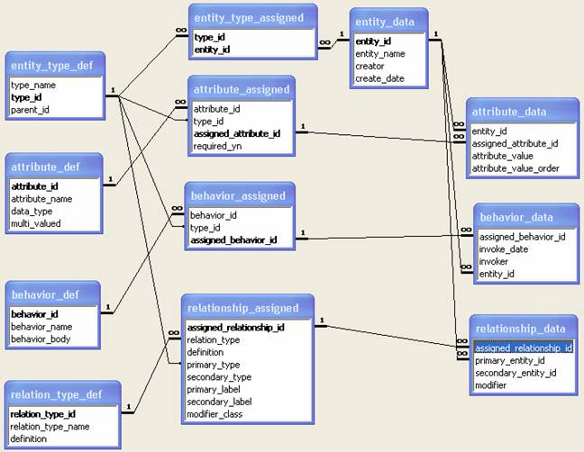
Relational Database

Slide 14
Entity Model
An ER model is an abstract way of describing a database.
In the case of a relational model, which stores data in tables, some of the data in these tables point to data in other tables - for instance, your entry in the database could point to several entries for each of the phone numbers that are yours.
The ER model would say that you are an entity, and each phone number is an entity, and the relationship between you and the phone numbers is 'has a phone number'.
Diagrams created to design these entities and relationships are called entity–relationship diagrams or ER diagrams.

Slide 15
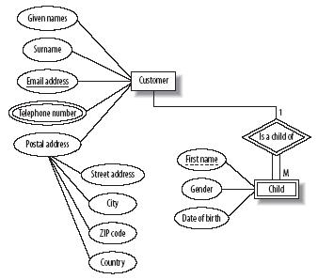
Entity Model

Slide 16
Object Model
An object database (also object-oriented database management system) is a database management system in which information is represented in the form of objects as used in object-oriented programming.
Object databases are different from relational databases which are table-oriented.
Object-relational databases are a hybrid of both approaches.

Slide 17
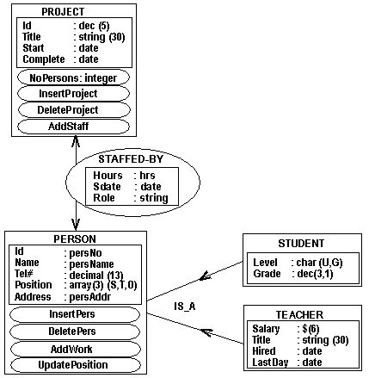
Object Model

Slide 18
Degrees of Data Abstraction (continued)
American National Standards Institute/Standards Planning and Requirements Committee (ANSI/SPARC)
Classified data models according to their degree of abstraction (1970s):
Conceptual
External
Internal
Physical

Slide 19
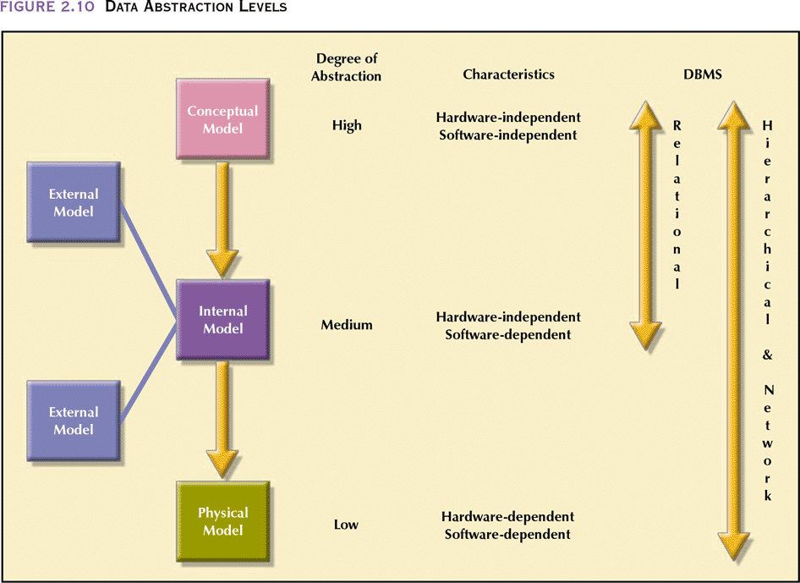
Data Abstraction Levels
Fig 3.2 Data Abstraction Levels

Slide 20
The Conceptual Model
Represents global view of the database
Enterprise-wide representation of data as viewed by high-level managers
Basis for identification and description of main data objects, avoiding details
Most widely used conceptual model is the entity relationship (ER) model

Slide 21
Advantages of Conceptual Model
Provides a relatively easily understood macro level view of data environment
Independent of both software and hardware
Does not depend on the DBMS software used to implement the model
Does not depend on the hardware used in the implementation of the model
Changes in either the hardware or the DBMS software have no effect on the database design at the conceptual level

Slide 22
Example of Conceptual View
EMPLOYEE
EMPLOYEE_NUMBER CHAR (6)
DEPT CHAR (8)
SALARY NUM (5)
SICK_DAYS NUM (3)

Slide 23
The Internal Model
Representation of the database as “seen” by the DBMS
Adapts the conceptual model to the DBMS
Software dependent
Hardware independent

Slide 24
Example of Internal View
C
struct employ {
char emp[6];
char dept[8];
}
COBOL
01 EMPLOY
02 EMP PIC X(6)
02 DEPT PIC X(8)

Slide 25
The External Model
End users’ view of the data environment
Requires that the modeler subdivide set of requirements and constraints into functional modules that can be examined within the framework of their external models
Good design should:
Consider such relationships between views
Provide programmers with a set of restrictions that govern common entities

Slide 26
Advantages of External Models
Use of database subsets makes application program development much simpler
Facilitates designer’s task by making it easier to identify specific data required to support each business unit’s operations
Provides feedback about the conceptual model’s adequacy
Creation of external models helps to ensure security constraints in the database design

Slide 27
The External Model
DBMS dependent
Hardware independent

Slide 28
Example of External View
STORED_EMP LENGTH = 46
EMP# TYPE = BYTE (6)
PAY TYPE = FULLWORD

Slide 29
The Physical Model
Operates at lowest level of abstraction, describing the way data are saved on storage media such as disks or tapes
Software and hardware dependent
Requires that database designers have a detailed knowledge of the hardware and software used to implement database design

Slide 30
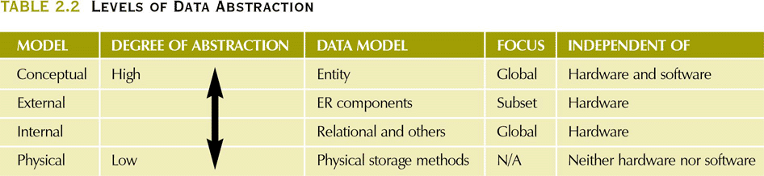
Levels of Data Abstraction
Fig 3.3 Levels of Abstraction

Slide 31
Database Users
User's are either:
Application programmers using conventional programming languages like Java, C++, C# etc
On-line terminal users using either a query language or a special purpose language tailored to that users requirements.
User's Language includes a Data Sublanguage (DSL)

Slide 32
DSL consists of 2 languages
Data Definition Language (DDL)
Definition and description of database objects by the user. e.g. definition of table, attribute names and value ranges
Data Manipulation Language (DML)
Provides for read / writing and processing of database objects. e.g. inserting, deleting, reading or updating data in the tables.

